Slide 1
Cache Memory
Lecture 03
Instructor: Tapushe Rabaya Toma
SWE, DIU.

Slide 2
Reference Books
Computer Organization and Architecture: Designing for Performance- William Stallings (8th Edition)
Any later edition is fine

Slide 3
Performance of Memory
Based on three performance parameters
Access time (latency): For random-access memory, this is the time it takes to perform a read or write operation
For non-random-access memory, access time is the time it takes to position the read–write mechanism at the desired location
Memory cycle time: This concept is primarily applied to random-access memory and consists of the access time plus any additional time required before a second access can commence
This additional time may be required for transients to die out on signal lines or to regenerate data if they are read destructively
Transfer rate: This is the rate at which data can be transferred into or out of a memory unit
For random-access memory, it is equal to 1/(cycle time)

Slide 4
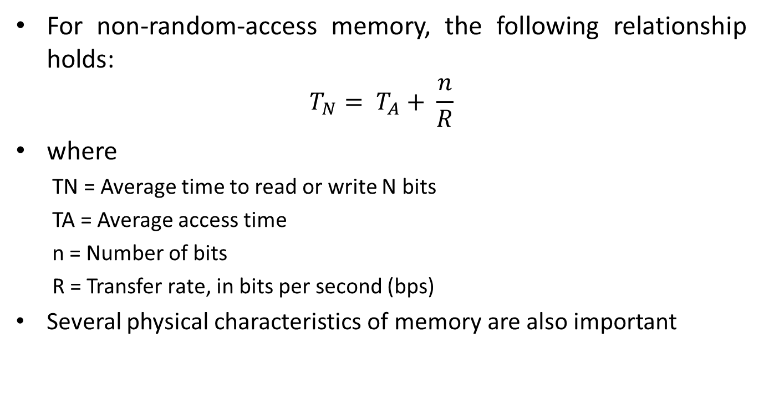
Performance of Memory
For non-random-access memory, the following relationship holds:
$$T_{N}= T_{A}+ \frac{n}{R}$$
where
TN = Average time to read or write N bits
TA = Average access time
n = Number of bits
R = Transfer rate, in bits per second (bps)
Several physical characteristics of memory are also important

Slide 5
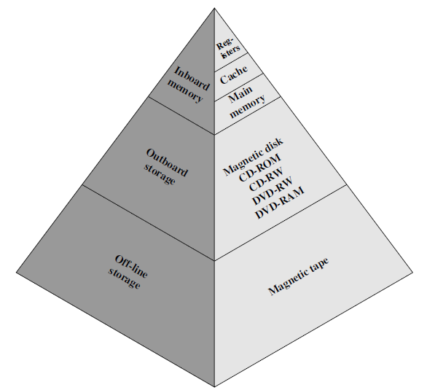
The Memory Hierarchy
Depends on:
Faster access time, greater cost per bit
Greater capacity, smaller cost per bit
Greater capacity, slower access time

Slide 6
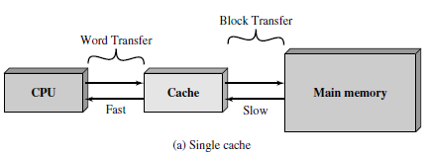
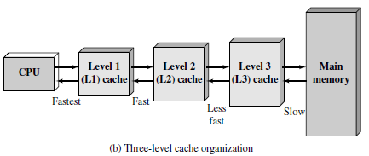
Cache Memory Principles

Slide 7
Cache Memory Principles
The cache contains a copy of portions of main memory
When the processor attempts to read a word of memory, a check is made to determine if the word is in the cache. If so, the word is delivered to the processor
If not, a block of main memory, consisting of some fixed number of words, is read into the cache and then the word is delivered to the processor
When a block of data is fetched into the cache to satisfy a single memory reference, it is likely that there will be future references to that same memory location or to other words in the block
Locality of reference

Slide 8
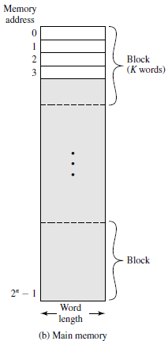
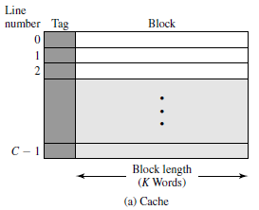
Cache Memory Structure

Slide 9
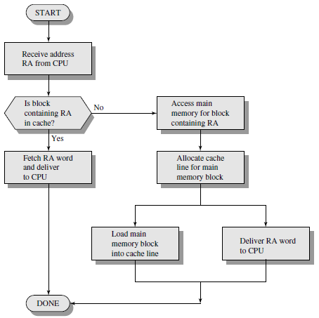
Cache Read Operation

Slide 10
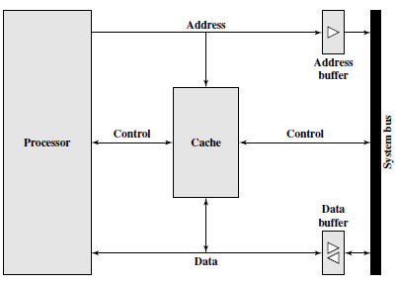
Typical Cache Organization

Slide 11
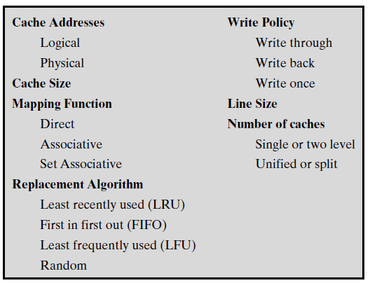
Elements Of Cache Design

Slide 12
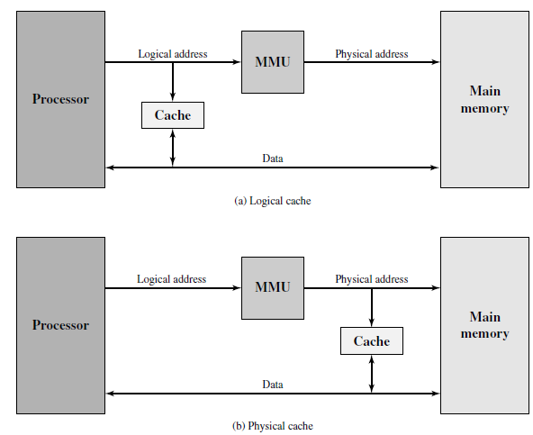
Cache Addresses

Slide 13
Mapping Technique
Performance of the cache memory mapping function
is key to the speed
• There are a number of mapping techniques
– Direct mapping
– Associative mapping
– Set associative - mapping

Slide 14
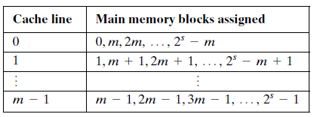

Direct Mapping
The mapping is expressed as:
$$i=j modulo m$$
where
i= cache line number
j = main memory block number
m = number of lines in the cache

Slide 15
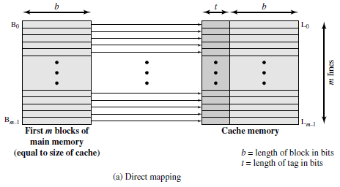
Mapping Mechanisms

Slide 16
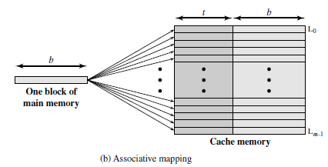
Mapping Mechanisms

Slide 17
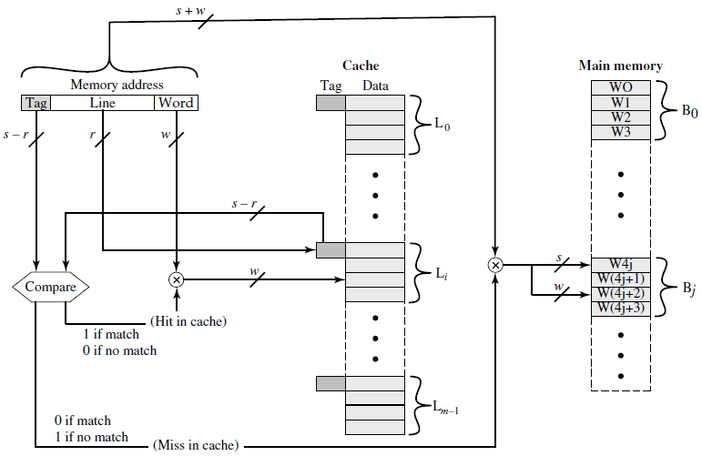
Direct Mapping Technique

Slide 18
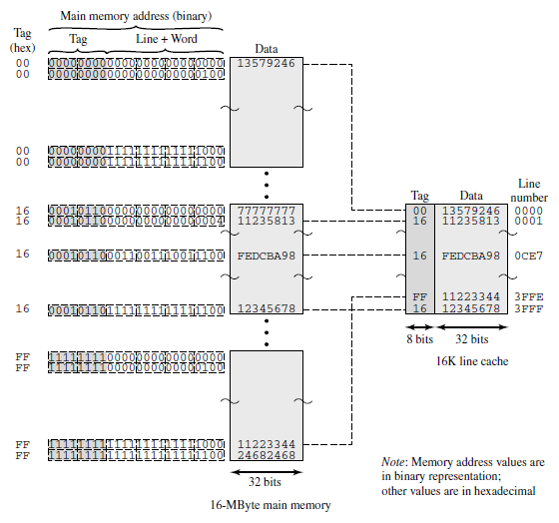
Direct Mapping Example

Slide 19

Direct Mapping Example
Advantage and Disadvantage?
Refer to text book

Slide 20
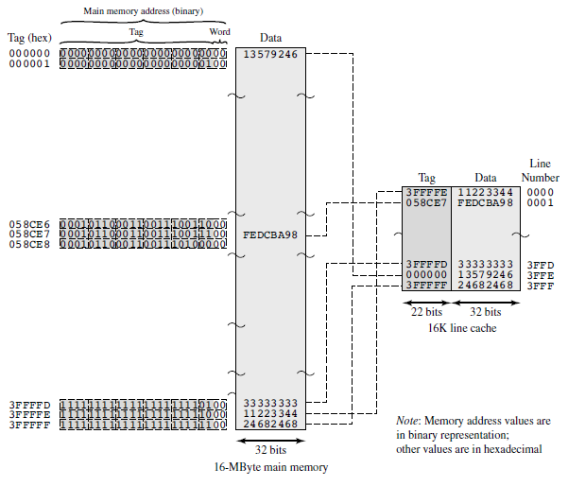
Fully Associative Cache Example

Slide 21

Fully Associative Cache Example
Advantage and Disadvantages?
Refer to textbook

Slide 22
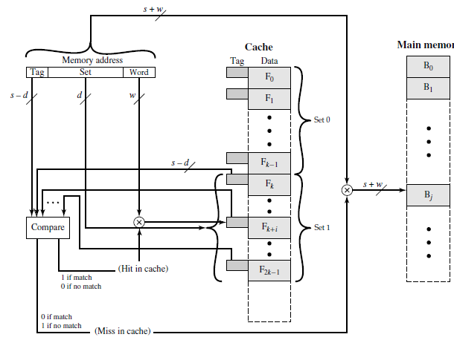
Set-associative Mapping

Slide 23
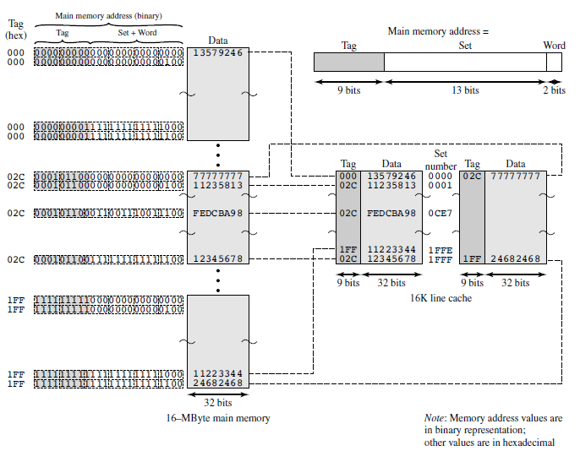
Set-associative Mapping (2- way set.)

Slide 24
Replacement Algorithms
Once the cache has been filled, when a new block is brought into the cache, one of the existing blocks must be replaced
For direct mapping, there is only one possible line for any particular block, and no choice is possible
For the associative and set-associative techniques, a replacement algorithm is needed
To achieve high speed, such an algorithm must be implemented in hardware

Slide 25
Replacement Algorithms
Least Recently Used (LRU)
Most effective
First-in-First-Out (FIFO)
Least Frequently Used (LFU)
For details: Find the book and study!

Slide 26
Write Policy
When a block that is resident in the cache is to be replaced, there are two cases to consider
If the old block in the cache has not been altered, then it may be overwritten with a new block without first writing out the old block
If at least one write operation has been performed on a word in that line of the cache, then main memory must be updated by writing the line of cache out to the block of memory before bringing in the new block

Slide 27
Write Policy
Two potential problems
More than one device may have access to main memory
If multiple processors are attached to the same bus and each processor has its own local cache

Slide 28
Write Policies
Write through
Simplest of all
Write back
Minimizes memory writes (dirty bit or use bit)

Slide 29
Write Policies
In a bus organization in which more than one device (typically a processor) has a cache and main memory is shared, a new problem is introduced
If data in one cache are altered, this invalidates not only the corresponding word in main memory, but also that same word in other caches
A system that prevents this problem is said to maintain cache coherency

Slide 30
Write Policies
Solutions:
Bus watching with write through
Hardware transparency
Non-cacheable memory

Slide 31
Thanks!

